Slide 1
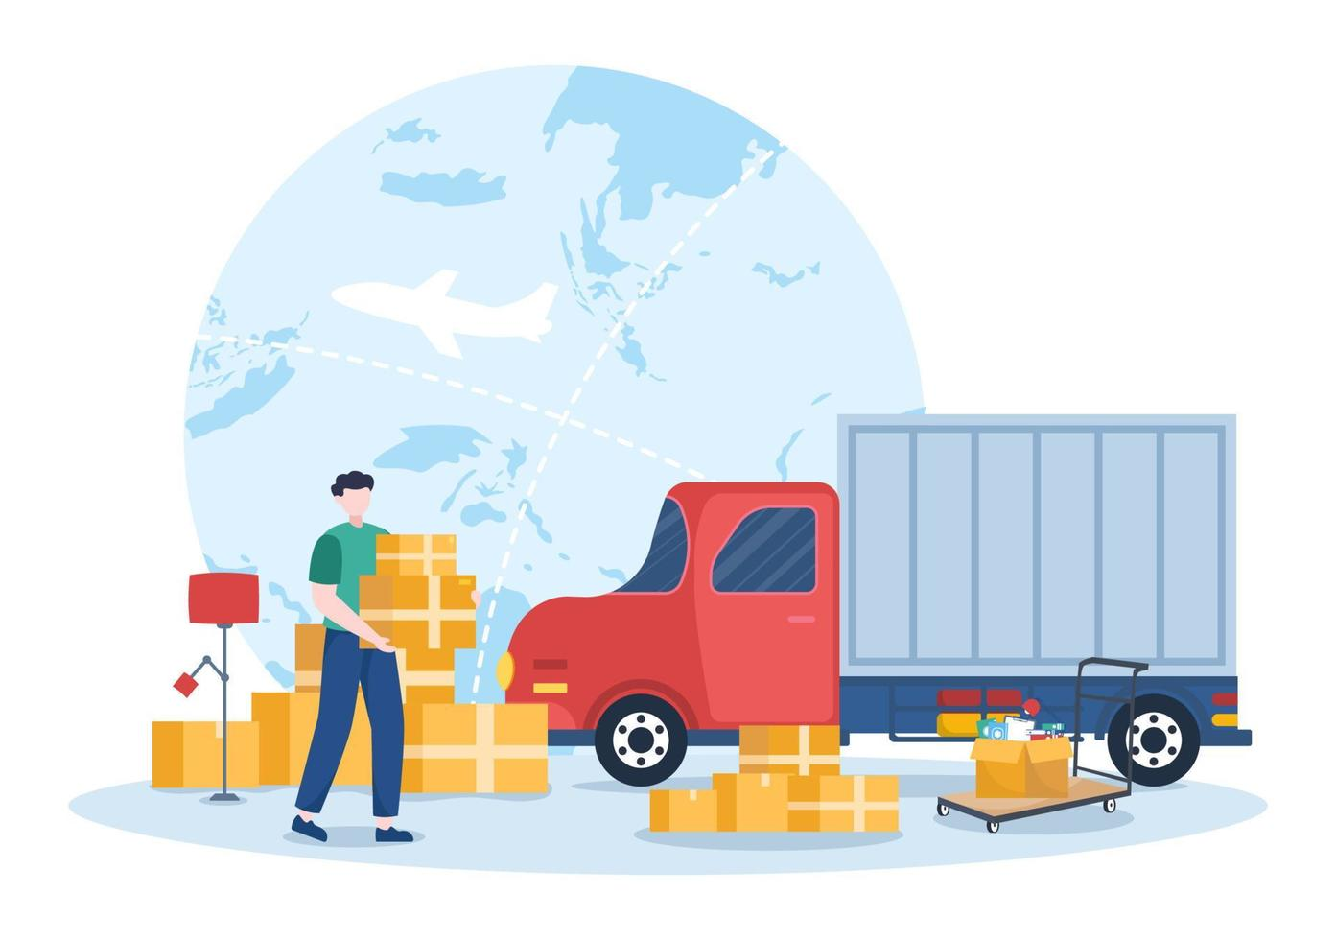

Advanced Databases
Parcel Service Application
Participants
Gayatri Samal
Ketan Darekar
Vipul Zope
Cris Kohn
Prateeksha Bheemareddy

Slide 2

AGENDA
User Story 1: Dynamic Route Optimization for Express Delivery
User Story 2: Real-Time Parcel Tracking
User Story 3: Packetstations Slot Availability and Package Deposit
User Story 4: Demand Analysis for Messenger Allocation
User Story 5: Drones delivery

Slide 3
INTRODUCTION
Welcome to Rapid Route Parcel Services, where every shipment we handle is sent on a journey designed with precision, care, and an unwavering dedication to quality. In the fast-paced world of package delivery, where the race against time is won in seconds and client trust is as valuable as the goods we transport, we are reinventing the dynamics of courier services.
At the heart of our business is a novel approach to logistics, which combines cutting-edge technology and human understanding to transform normal shipping into a thoughtfully created service experience. Our network, which spans continents and cultures, leverages the power of modern routing technology and real-time data analytics to ensure that every package not only reaches its destination safely but also with maximum efficiency and sustainability.

Slide 4
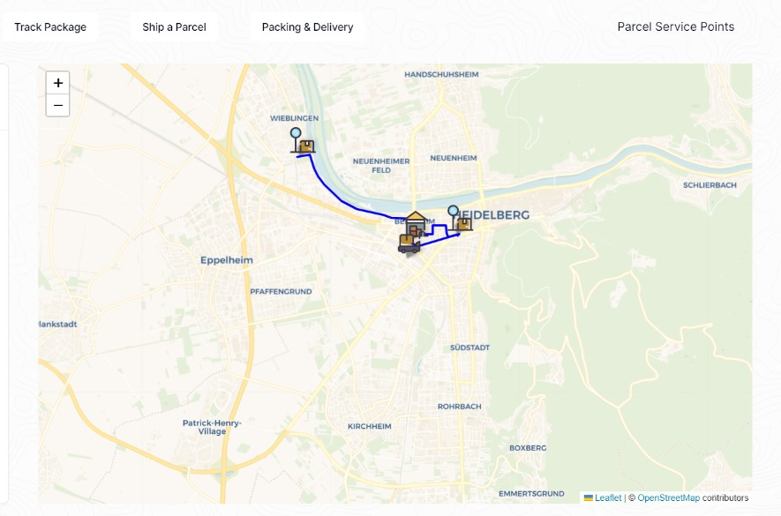
USER STORY 1: By Gayatri Dynamic Route Optimization for Express Delivery
As a messenger, I want to see how many parcels are pending for deliver for different locations, I want to see a dynamic routing system that provides real-time optimized delivery routes based on traffic, roadworks, and other unforeseen delays, so that I can deliver parcels efficiently and minimize travel time and distance also fuel consumption.

Slide 5
TASK DESCRIPTION
The dynamic optimization of parcel delivery routes begins at the distribution center, where each messenger is assigned a GPS-equipped van loaded with parcels. The routing system then calculates the most efficient routes based on factors such as the starting point, parcel load, and projected delivery times, adapting in real-time to traffic, roadworks, and accidents. Messengers use a mobile app or GPS to follow and adjust these routes. Each delivery is confirmed by scanning the parcel at the destination, with details uploaded to a central system for real-time tracking. Customers are kept informed through automated notifications with tracking IDs and estimated delivery times, allowing them to track and confirm receipt of their parcels via web or mobile interfaces.

Slide 6
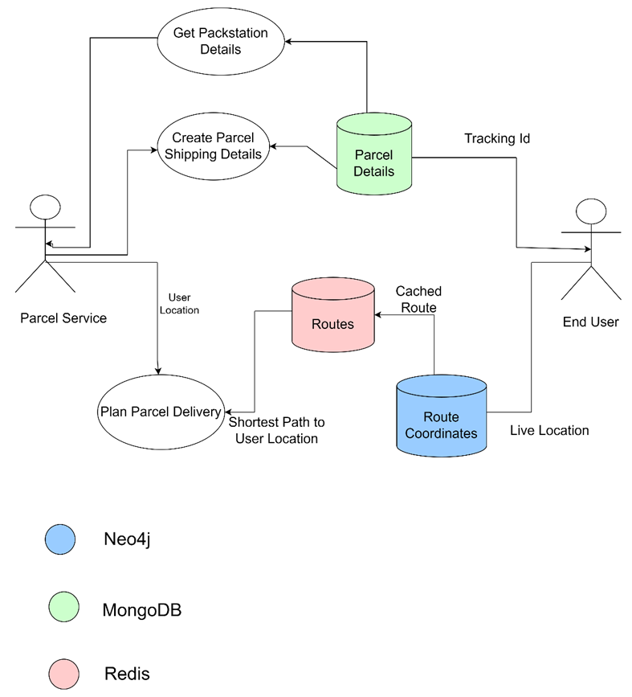
DATAFLOW

Slide 7
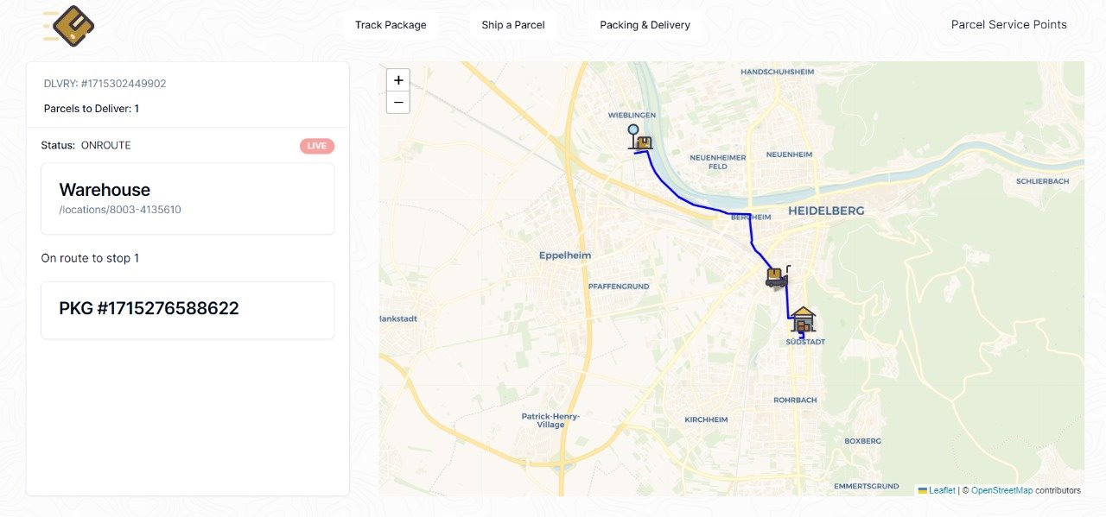
USER STORY 2: By Ketan Real-Time Parcel Tracking
As an User, I want to track the real-time location of my parcel and receive notifications at key delivery stages, so that I can monitor its progress and be informed about any delays or exceptions.

Slide 8
TASK DESCRIPTION
Description: This task involves developing and integrating a real-time tracking system that monitors parcels at every stage of the delivery journey. The system should provide customers with access to live updates via a user-friendly interface, ensuring they receive accurate and timely information about their parcel's progress. This initiative aims to improve transparency and allow customers to conveniently monitor their deliveries, thereby increasing overall service reliability and customer confidence in the delivery process.

Slide 9
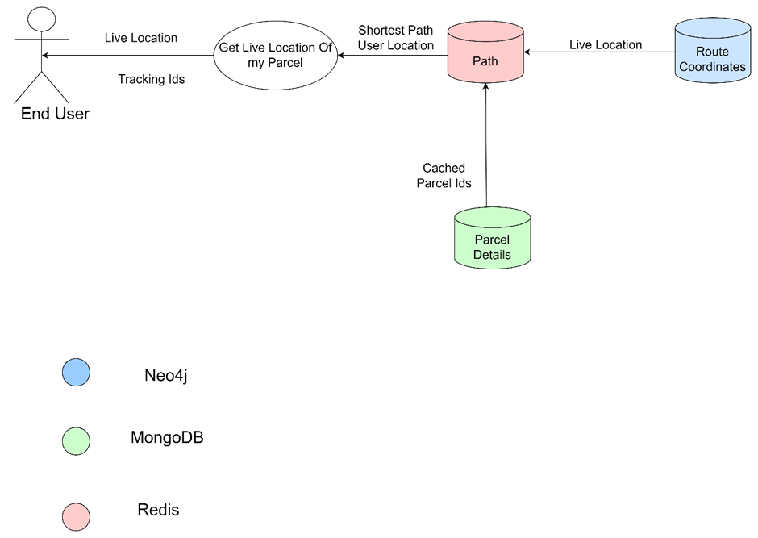
DATAFLOW

Slide 10
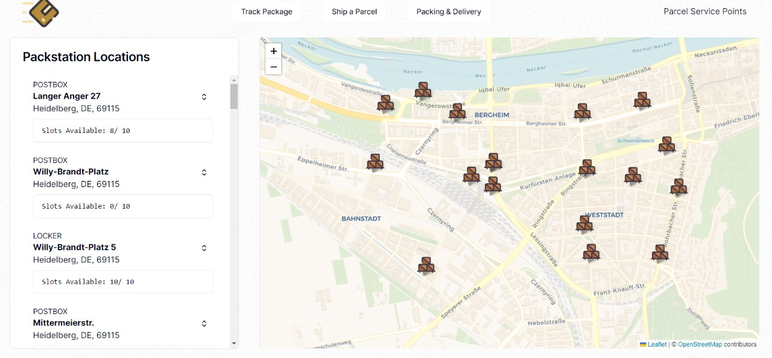
USER STORY 3: By Prateeksha Packstation Slot Availability and Package Deposit
As a user, I want to locate nearby packstations with available slots for package deposit, so that I can efficiently deposit my package at a convenient location and track its delivery.

Slide 11
TASK DESCRIPTION
Utilizing the obtained location, the app proceeds to query the integrated database system, aiming to identify nearby packstations where the user can deposit the package for shipping. These packstations are strategically scattered across Heidelberg to ensure accessibility and convenience for the users. Upon retrieving the list of nearby packstations, the app meticulously organizes and presents this information to the user in a clear and intuitive manner. The user, now equipped with the list, can evaluate, and select the most suitable packstation based on factors such as proximity, operational hours, and available services.. This action triggers another database query, this time directed towards retrieving detailed information about the available slots at the chosen packstation. Each packstation boasts a finite number of slots, each differing in size and capacity.

Slide 12
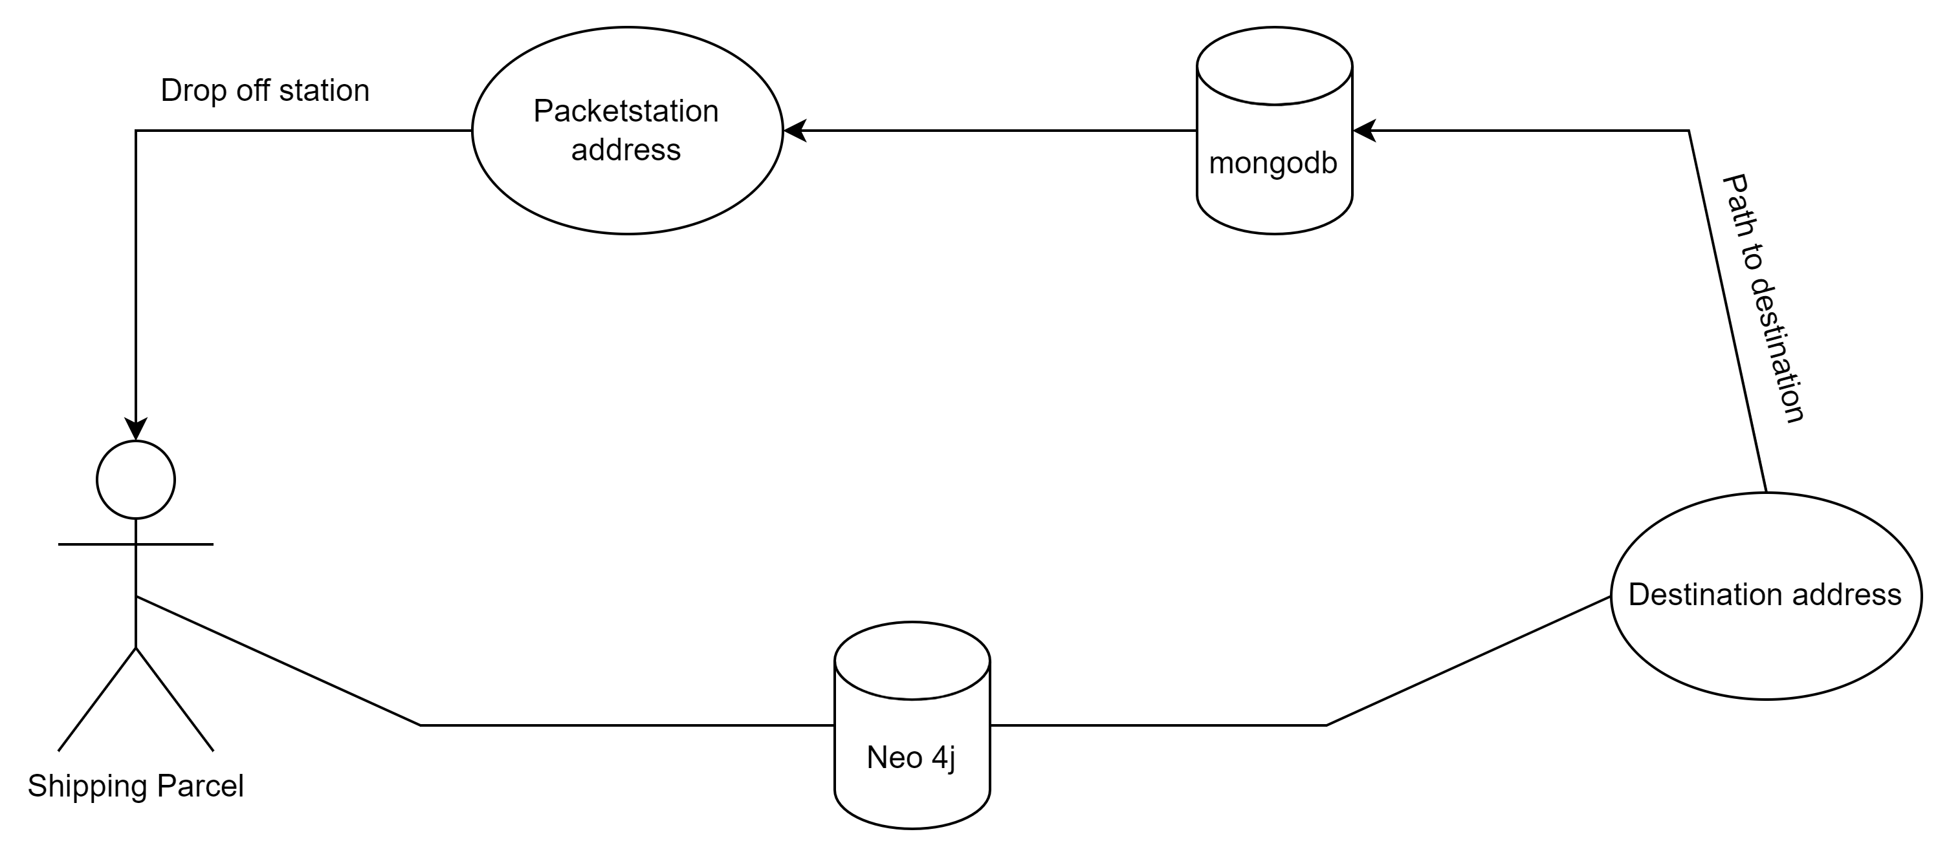
DATAFLOW

Slide 13
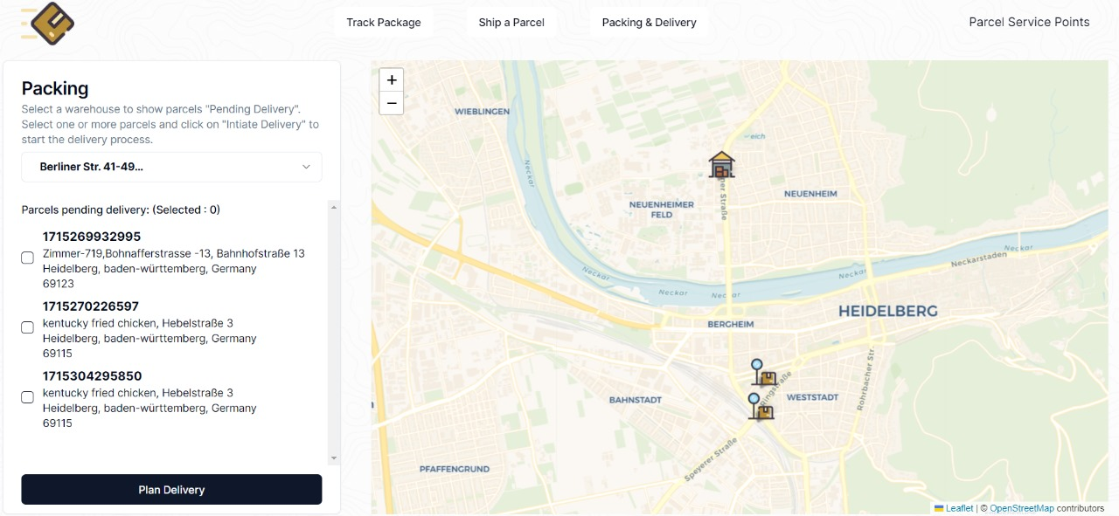
USER STORY 4: By Vipul Demand Analysis for Messenger Allocation
The system will analyze delivery demand in different areas based on parcel priorities and historical data, so that I can allocate messengers effectively to meet service demands and prioritize urgent deliveries.

Slide 14
TASK DESCRIPTION
To improve messenger allocation and prioritize urgent deliveries, this task involves analysing delivery data and parcel priorities across different areas.
Description: Begin by noting parcel priorities and volumes by location. By doing analysis of this data to identify trends and patterns in demand across various regions .
Evaluate current messenger resources against these demands to highlight inefficiencies. Develop and implement a strategic plan for reallocating messengers, ensuring that areas with high priority deliveries are prioritized. Finally, set up a monitoring system to evaluate the effectiveness of these changes. This will lead to more efficient messenger use and higher customer satisfaction due to timely and prioritized delivery handling.

Slide 15
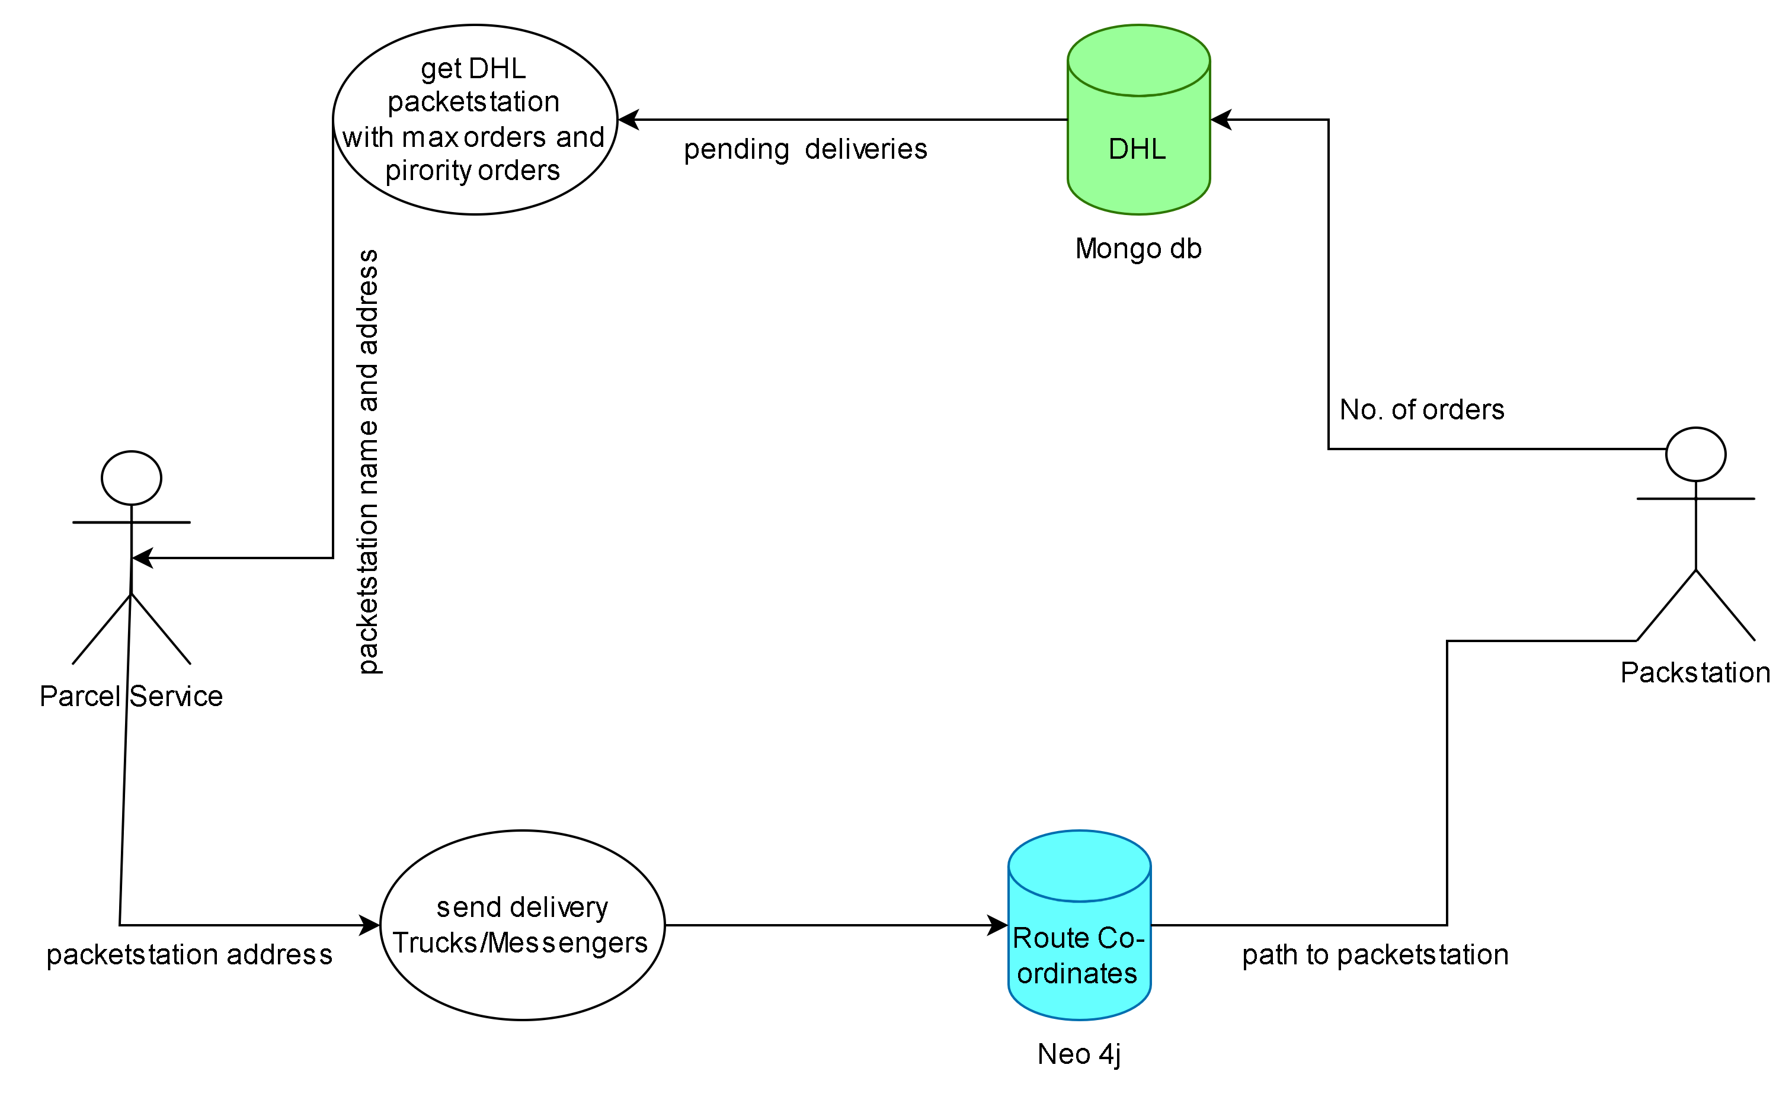
DATAFLOW

Slide 16
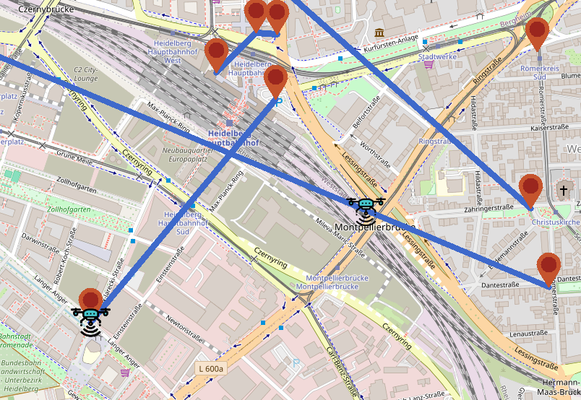
USER STORY 5: By Cris Drones delivery

Slide 17
TASK DESCRIPTION
Fictive use case
Parcels are delivered to specific clients in Heidelberg
Admin wants to see a map with
The addresses as markers
The live location of the drones (updating every second)
The current routes of the drones (line between 2 markers)

Slide 18
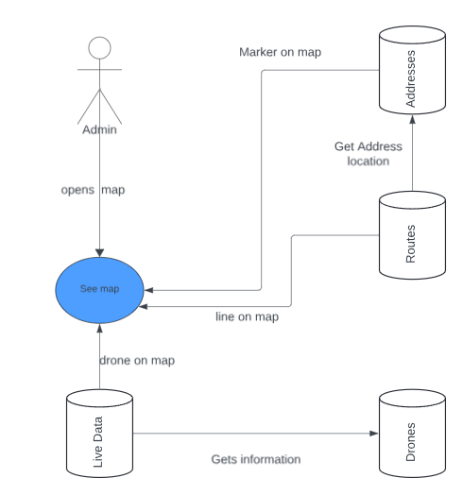
DATAFLOW
MongoDB:
Addresses
Drones
Neo4J
Routes with location ids
Redis:
Current Position
Battery status
Drone name as key

Slide 19

DEMO

Slide 20

THANK YOU

